Slide 1




Ett hållbart ekosystem för implementering av UNESCO:s OER rekommendation
29 november 2022
SVERD i samarbete med UHR välkomnar till ett webbinarium om öppna lärresurser - Open Educational Resources (OER)
Professor, Dr. Ebba Ossiannilsson
V Ordförande, SVERD
Chair ICDE OER Advocacy Committee
Pedagogisk Utvecklare, Mats Brenner
Ledamot, SVERD
Karolinska institutet

Slide 2
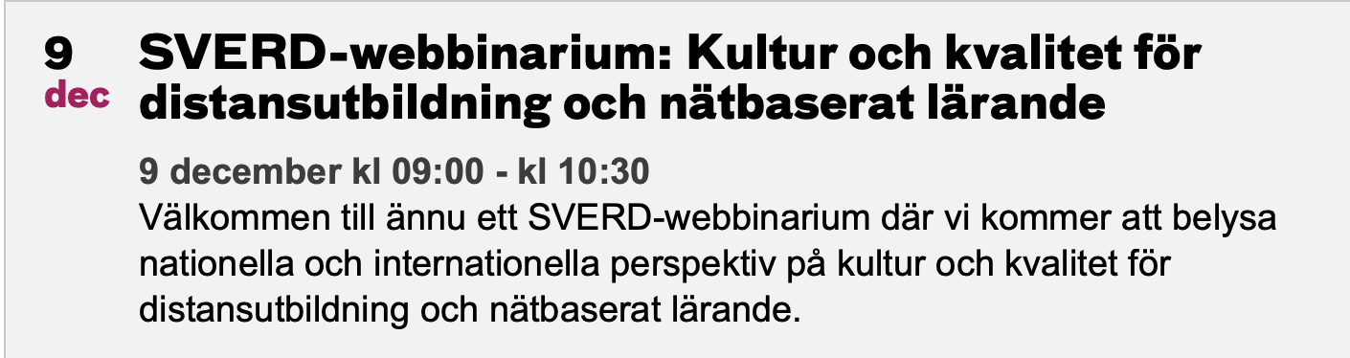
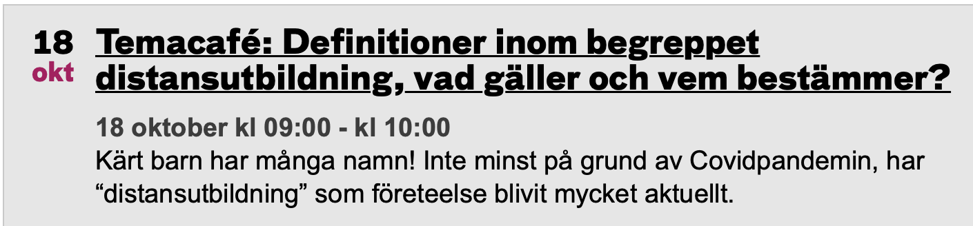
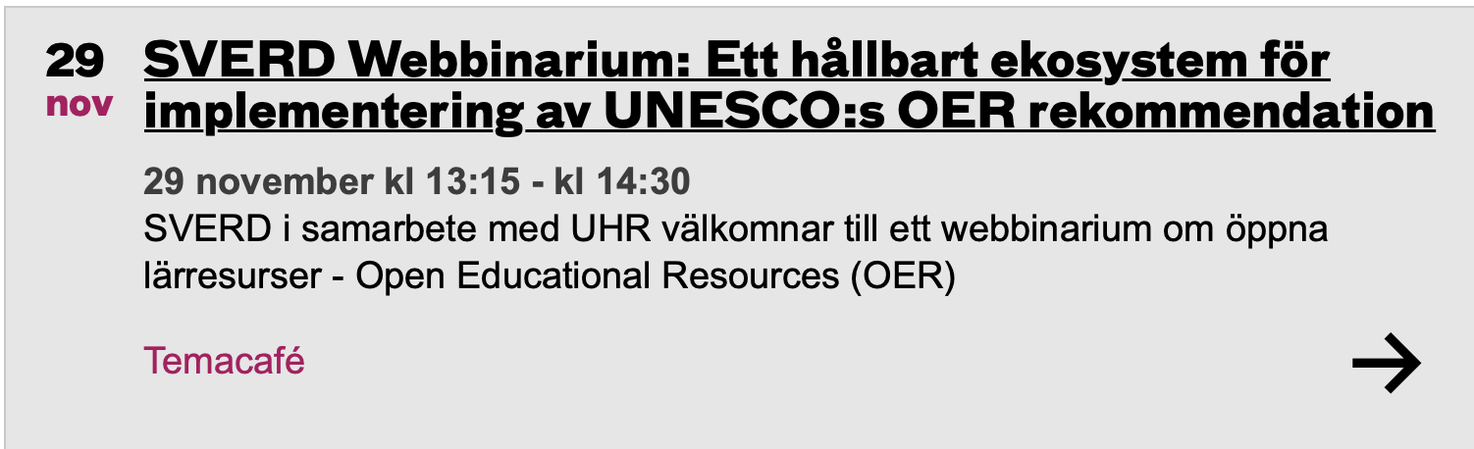
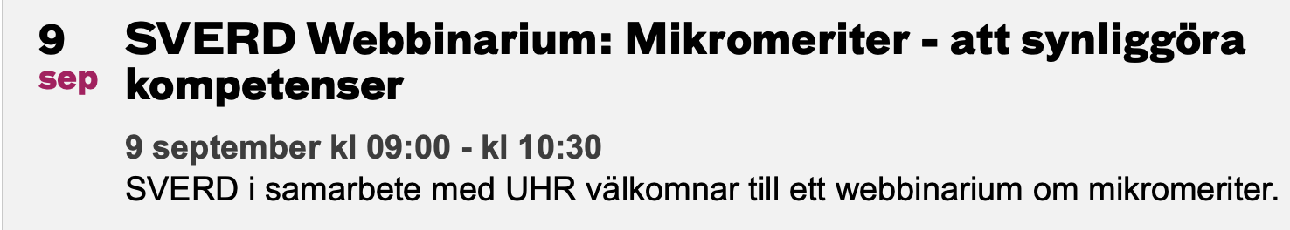
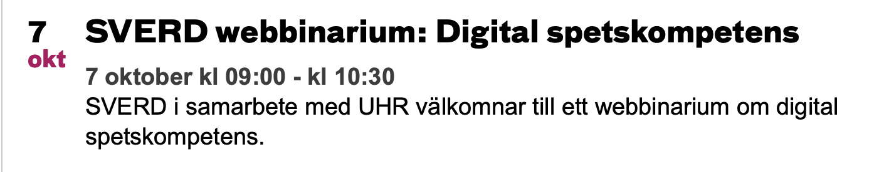

Slide 3
AGENDA
UNESCO:s OER-rekommendation presenteras
ICDE OER Advocacy Committee, dess globala arbete och advocacy campaign presenteras, samt
Information om The CARE (Contribute, Attribute, Release, Empower) Framework
Om Mötesplats OER (som även hade konferens 25/11 2022)
Regeringsuppdrag från Utbildningsdepartementet om öppna lärresurser och allmänhetens delaktighet i forskningsprocessen
Medverkande:
Ebba Ossiannilsson Svenska Riksorganisationen för öppen flexibel distansutbildning (SVERD) International Council for Open and Distance Education (ICDE) OER Ambassador och Chair
Josefine Hellroth Larsson, Wikimedia och Mötesplats OER
Erik Stattin, Kungliga biblioteket (KB)

Slide 4
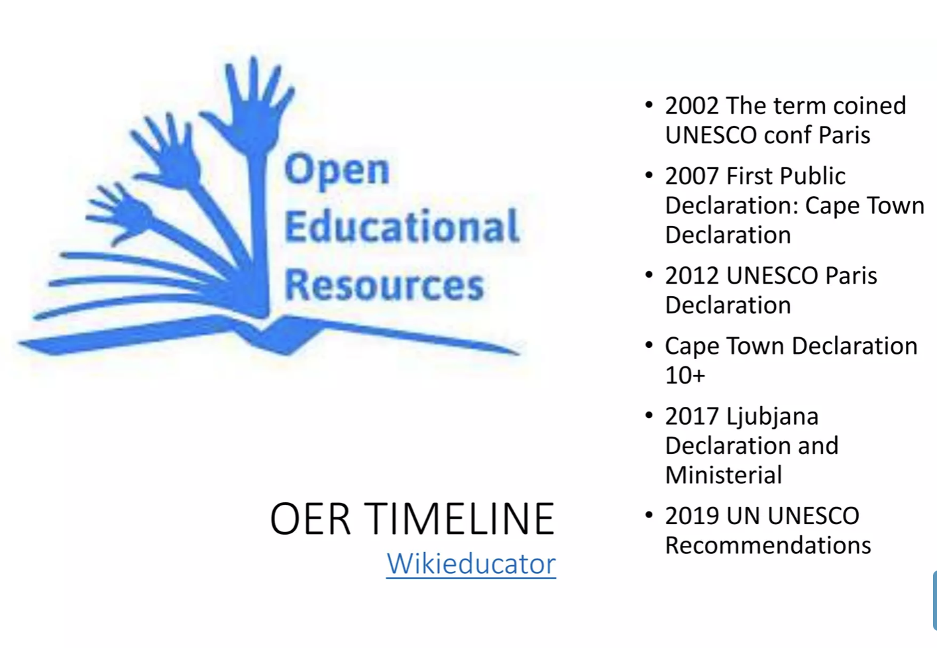

Slide 5


Building on the Ljubljana OER Action Plan 2017 to mainstream OER to help all Member States to create inclusive knowledge societies and achieve the 2030 Agenda for Sustainable Development, namely SDG 4 (Quality education), SDG 5 (Gender equality), SDG 9 (Industry, innovation and infrastructure), SDG 10 (Reduced inequalities within and across countries), SDG 16 (Peace, justice and strong institutions) and SDG 17 (Partnerships for the goals).
PREAMBLE
The General Conference of the United Nations Educational, Scientific and Cultural Organization (UNESCO), meeting in Paris from 12 to 27 November 2019, at its 40th session (25th Nov 2019)
Recalling that the Preamble of UNESCO’s Constitution affirms, “that the wide diffusion of culture, and the education of humanity for justice and liberty and peace are indispensable to the dignity of man and constitute a sacred duty which all the nations must fulfil in a spirit of mutual assistance and concern”,

Slide 6


https://unesco.se/wp-content/uploads/2022/09/Unescos-rekommendationer-om-opppna-larresurser-ny.pdf

Slide 7
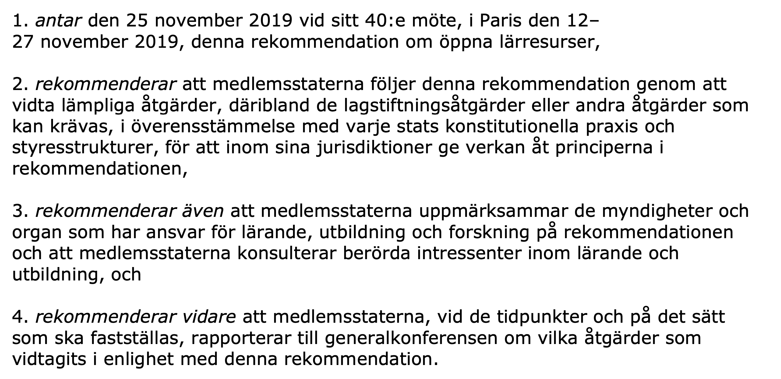

Slide 8
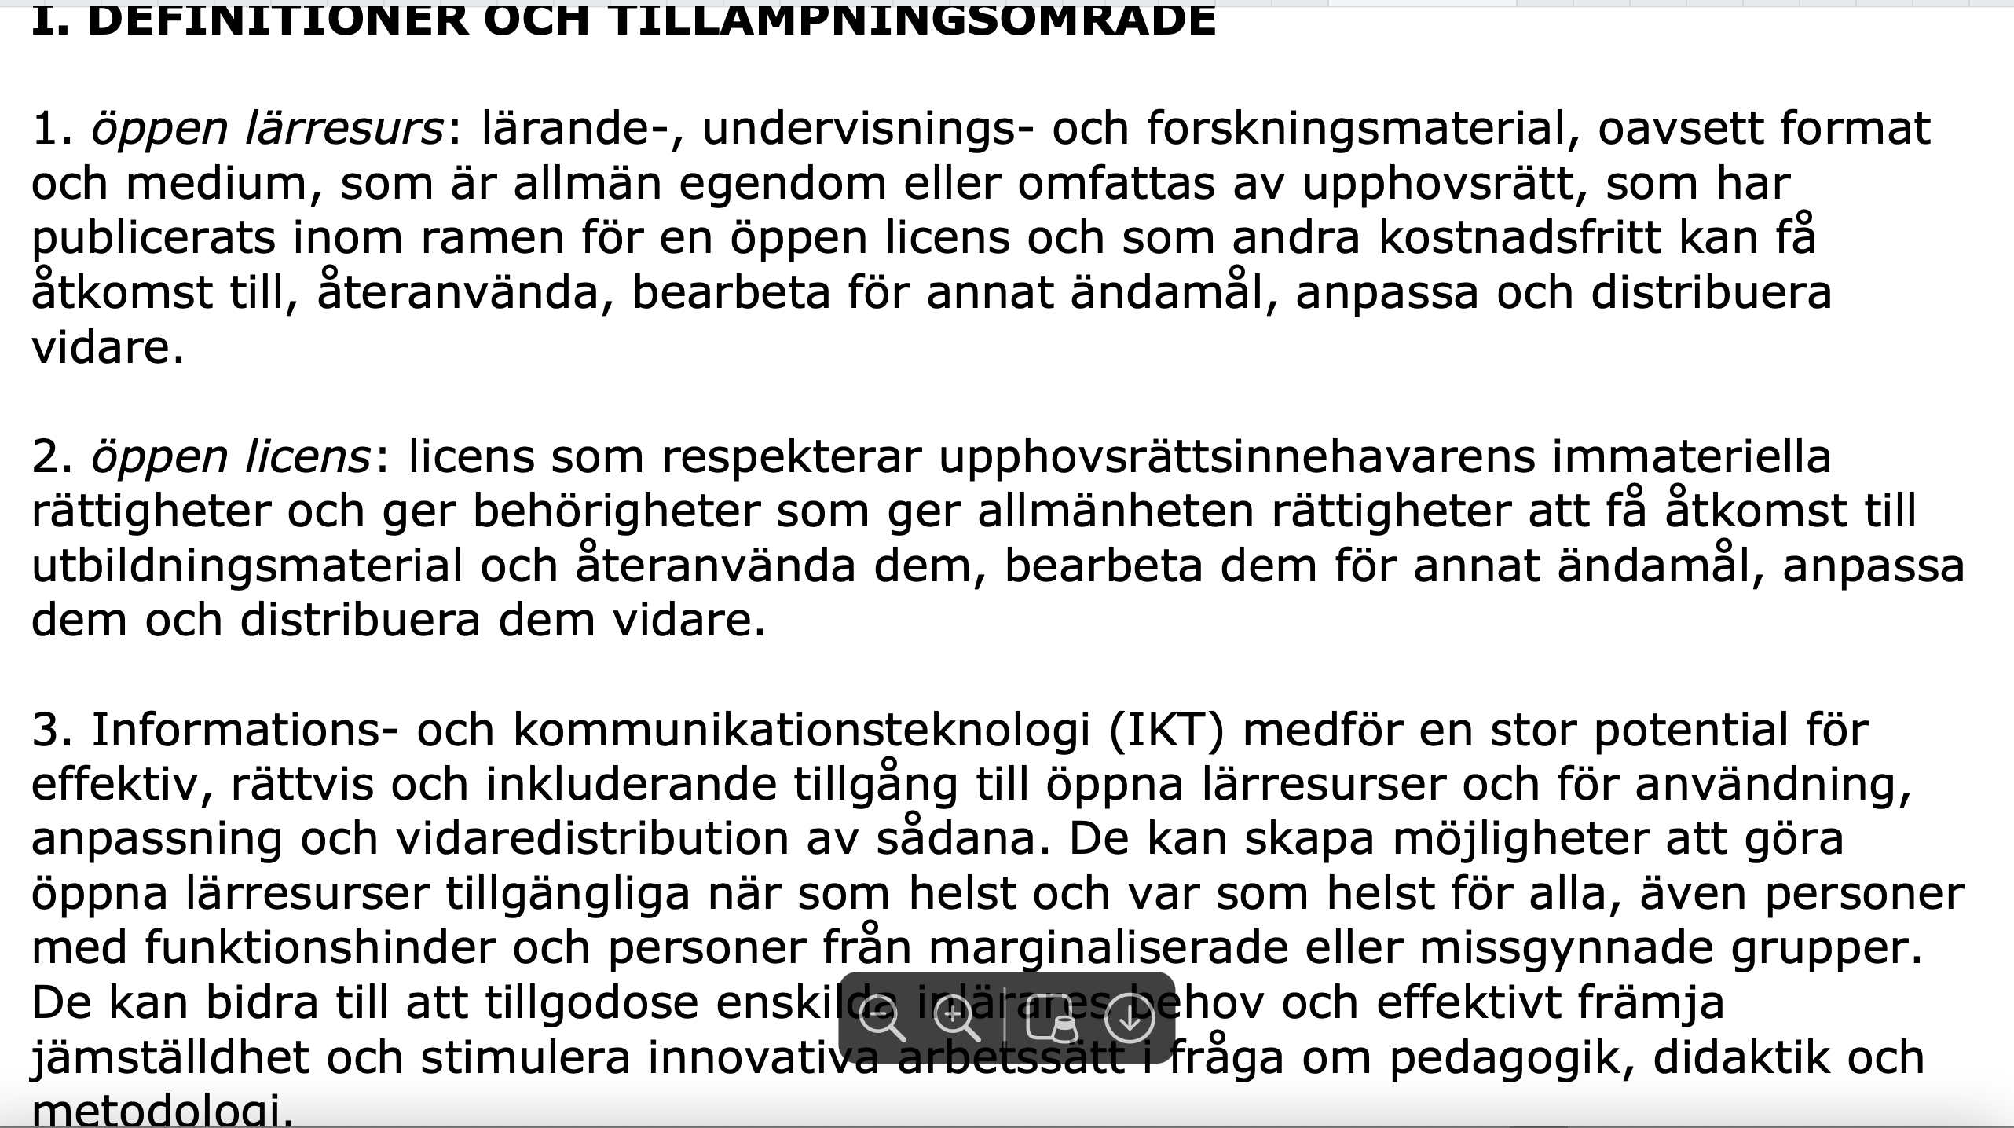

Slide 9


Slide 10
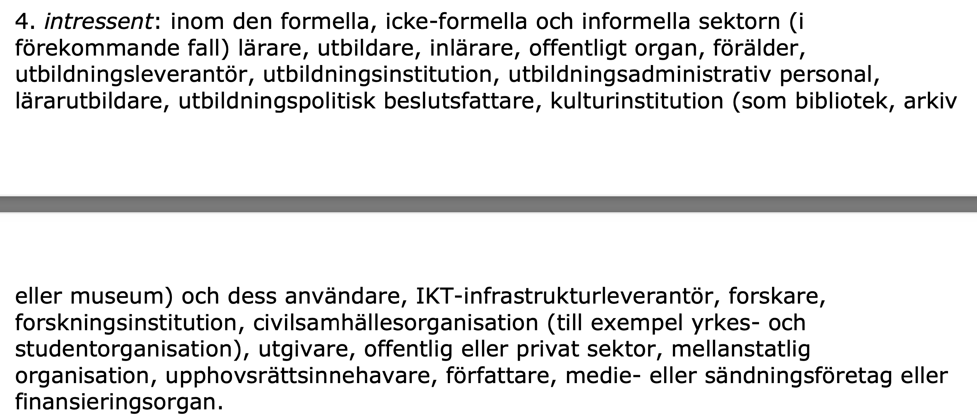

Slide 11
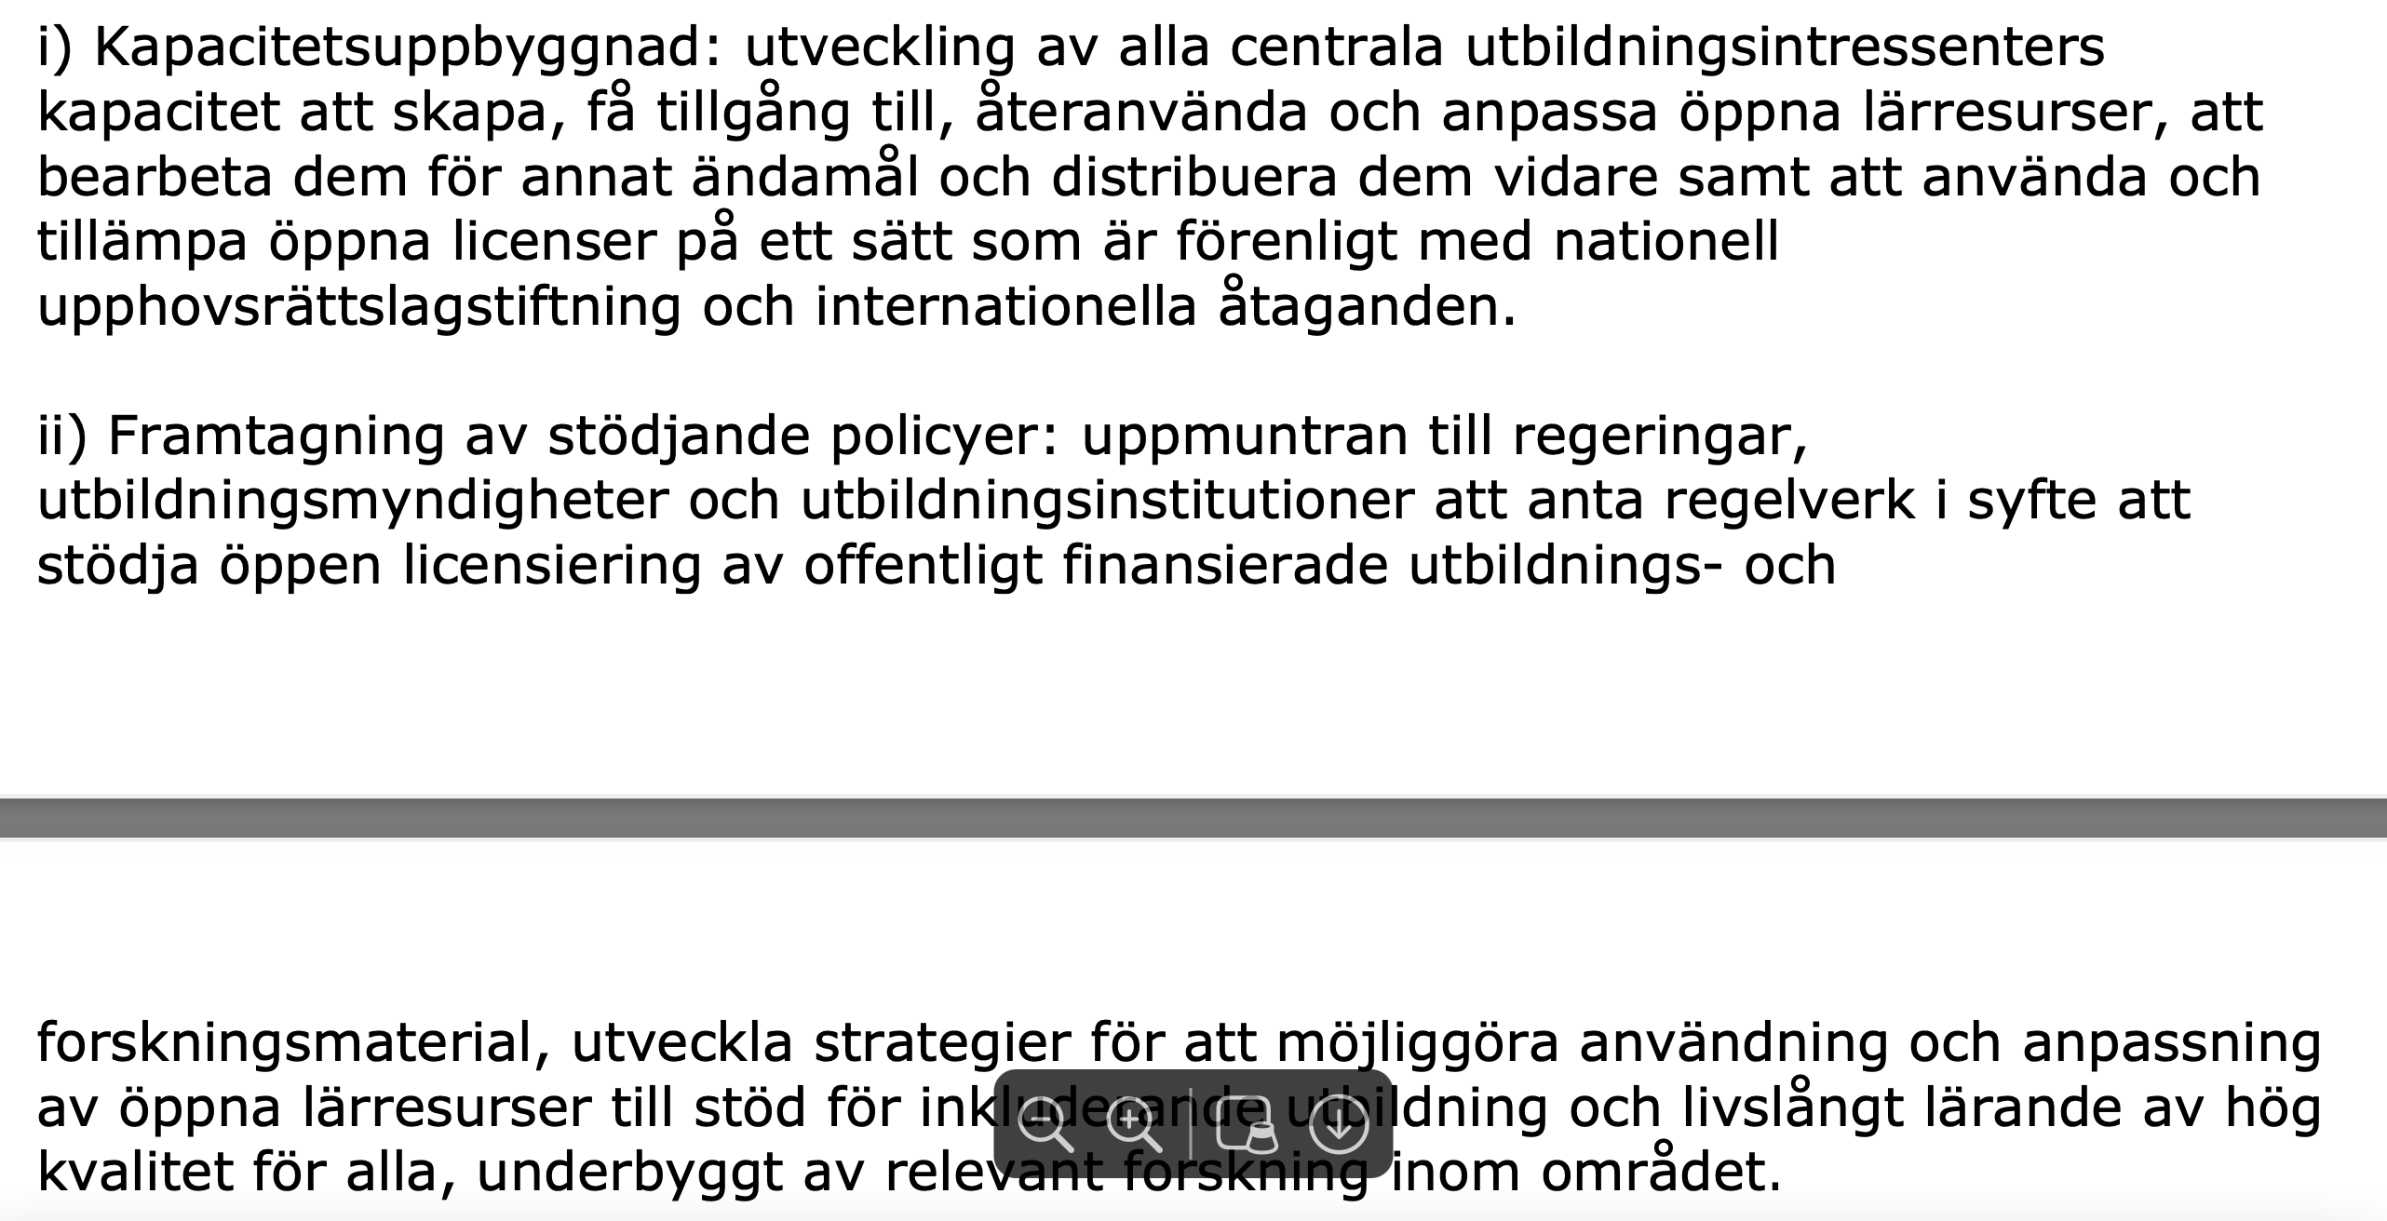
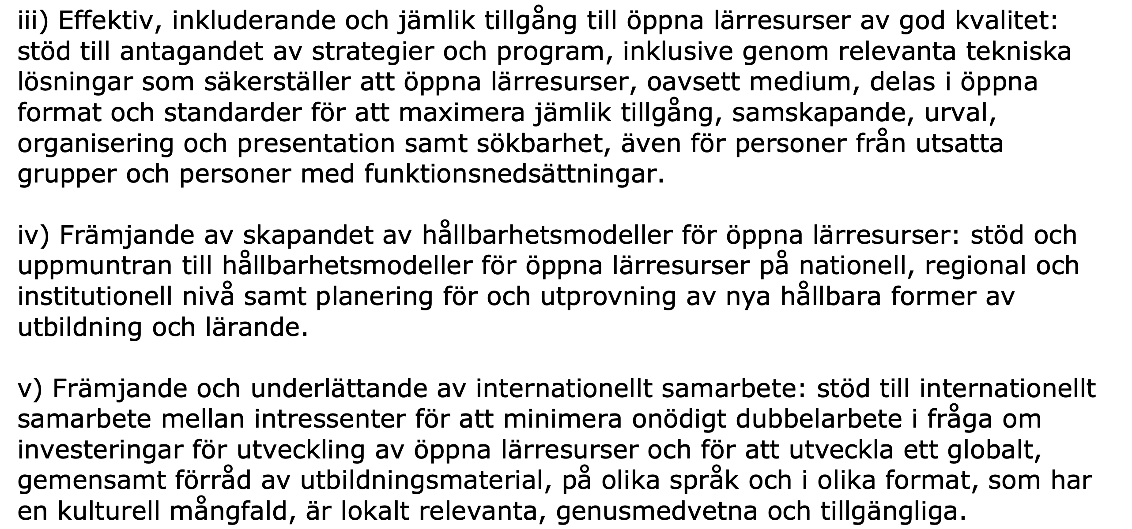

Slide 12
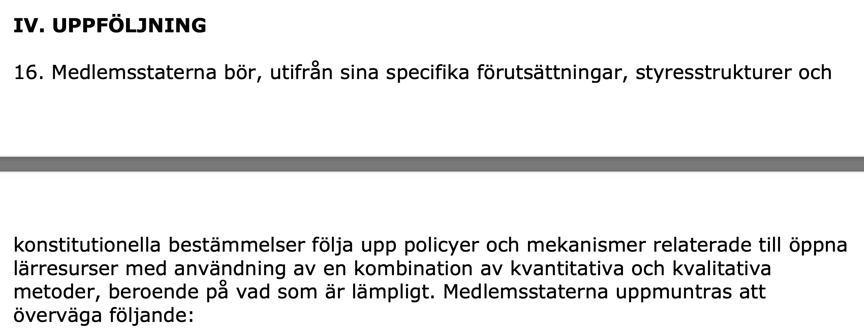
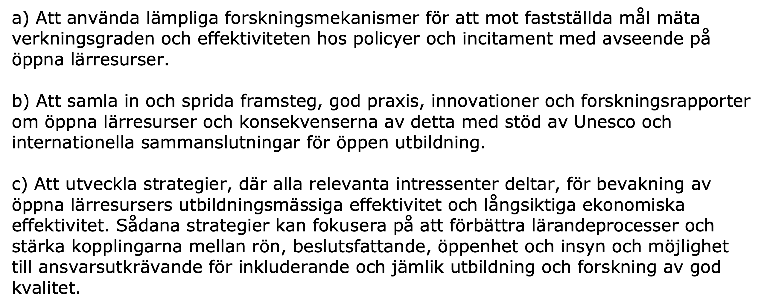

Slide 13
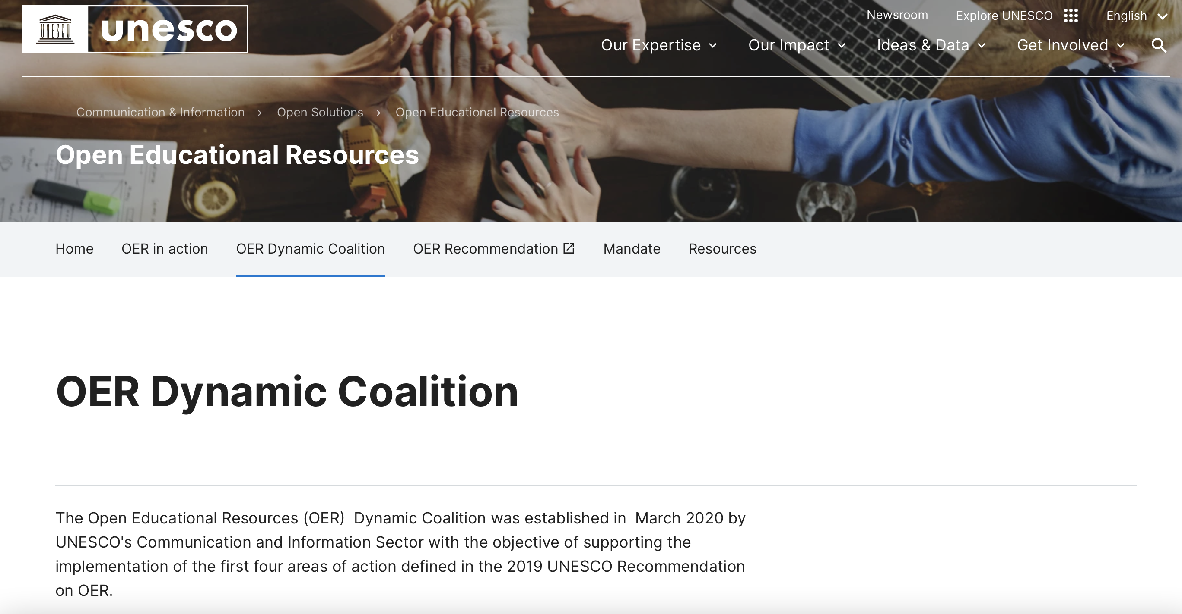

Slide 14
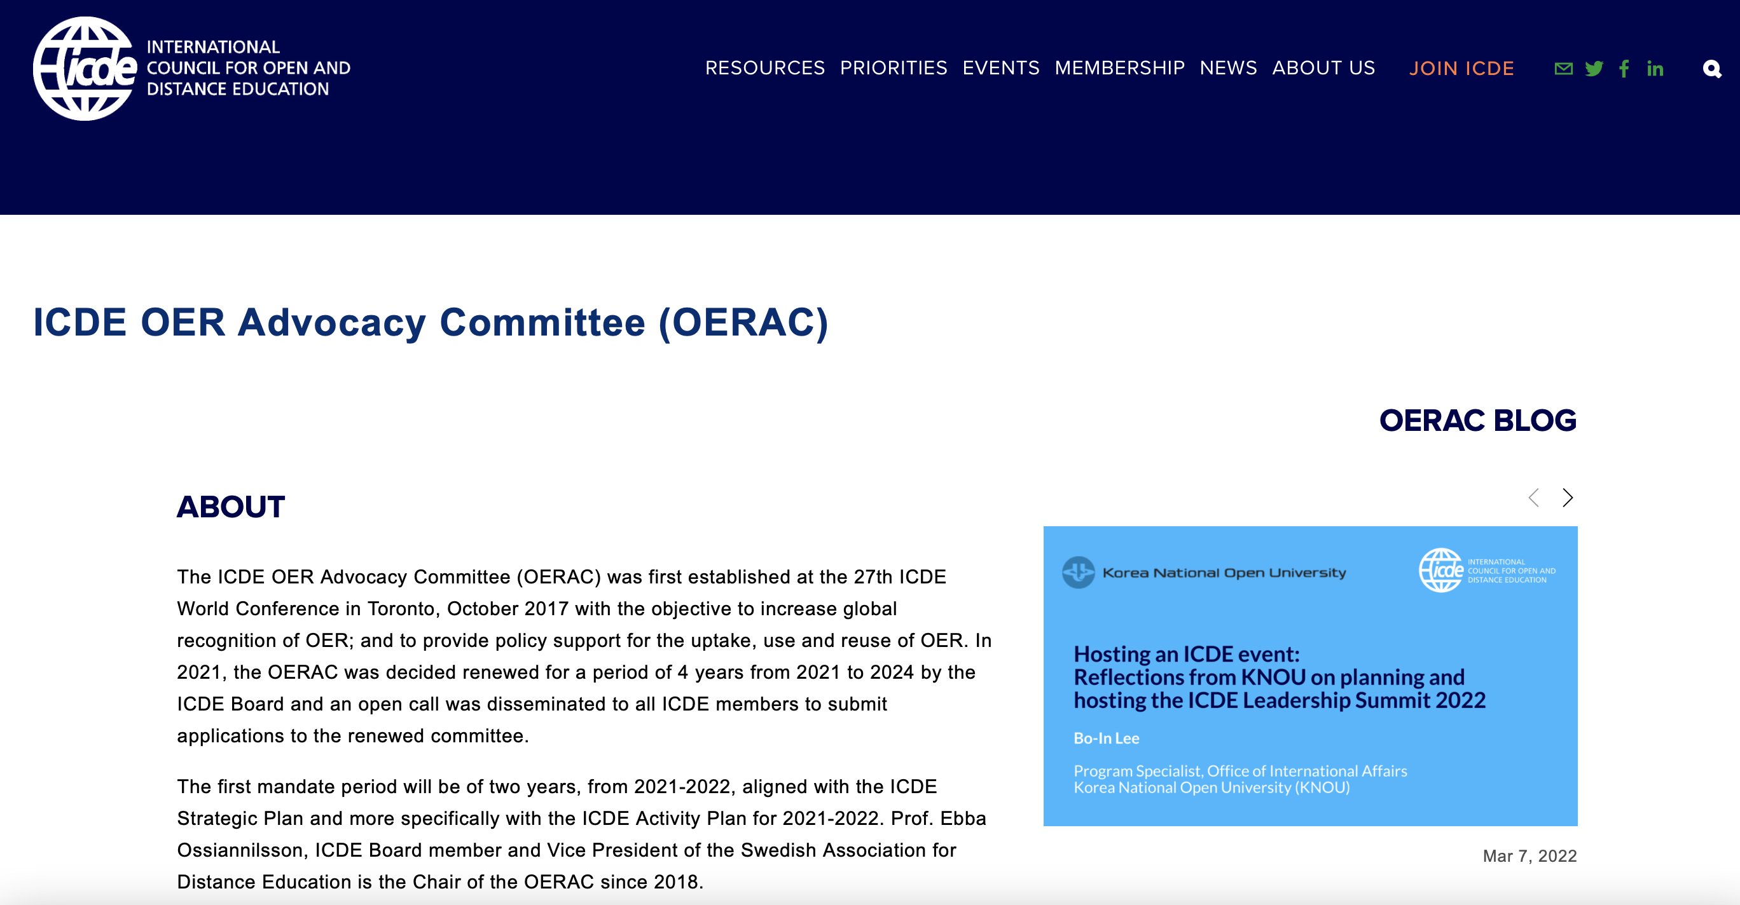
https://www.icde.org/knowledge-hub/icde-oer-advocacy-committee

Slide 15



ICDE OER ADVOCACY COMMITTEE
THE 2021-2022 OERAC DRAFT MANDATE
The 2021-2022 OERAC mandate is based on the ICDE Strategic Plan 2021-2024 and ICDE Activity Plan 2021-2022, the UNESCO Recommendation on OER from 2019 and ICDEs role as a partner in the UNESCO OER Dynamic Coalition. The mandate also builds on recommendations from the Final report from the OERAC for 2020.

Slide 16
ICDE OER ADVOCACY COMMITTEE AMBASSADORS
Ebba Ossiannilsson - Professor, Dr Consultant, VP, Swedish Association of Distance Education (SADE), ICDE Board, Chair
Jane-Frances Obiageli Agbu - Associate Professor, National Open University of Nigeria, Nigeria
Cengiz Hakan Aydin - Professor, Anadolu University, Turkey
Melinda de la Pena Bandalaria - Chancellor, Professor, University of the Philippines Open University, Philippines
Daniel Burgos - Vice-rector for International Research, Universidad Internacional de La Rioja, Spain
Xiangyang Zhang - Emeritus Professor, Open University of Jiangsu, China
Rosa Leonor Ulloa Cazarez - Professor, Universidad de Guadalajara, Mexico
Mpine Makoe - Professor, University of South Africa (UNISA), South Africa
Cristine Gusmao - Associate Professor, Federal University of Pernambuco, Brazil
Yi Yang - Professor, Franklin University, USA
Constance Blomgren - Associate Professor, Athabasca University, Canada
Trish Chaplin-Cheyne - Director Learning and Teaching Development, Otago Polytechnic, New Zealand

Slide 17
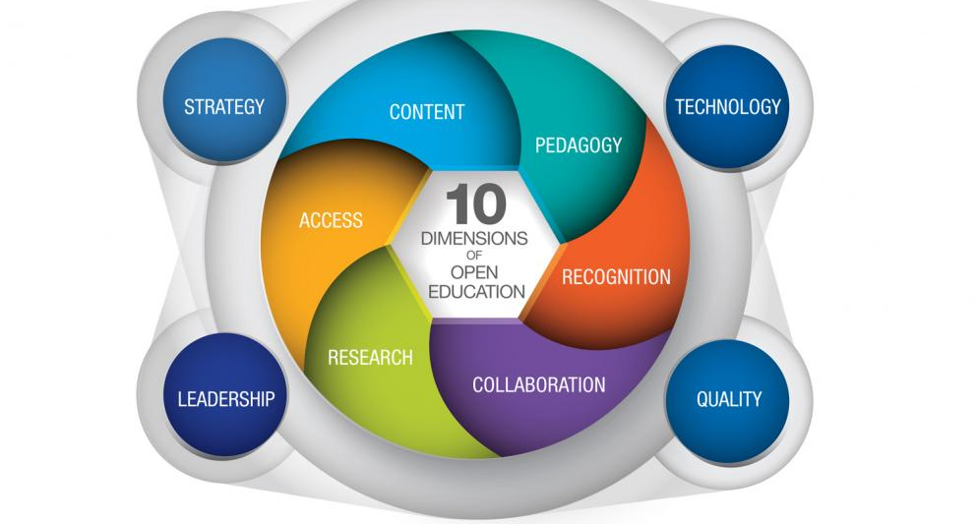

Slide 18
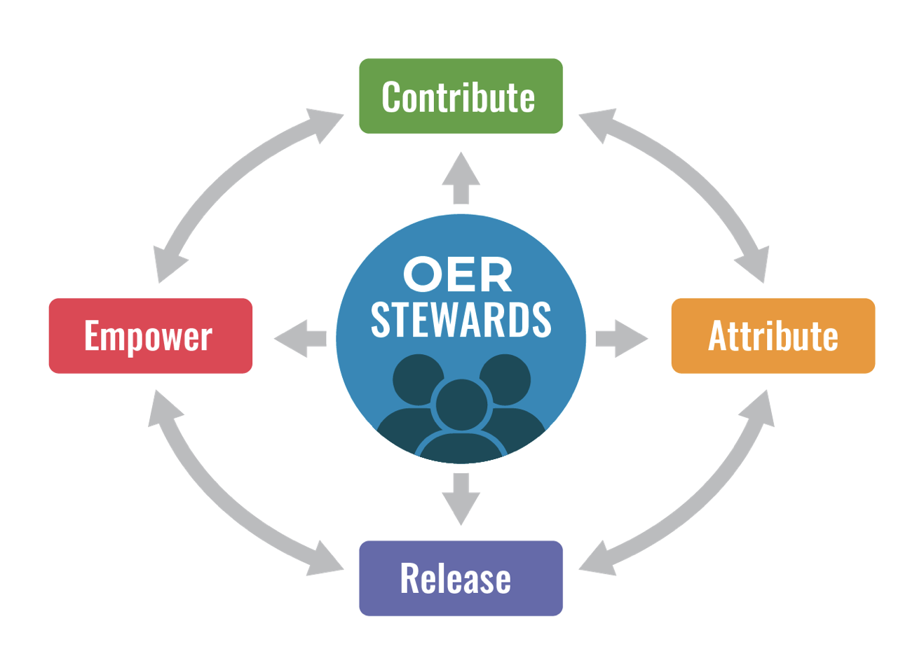
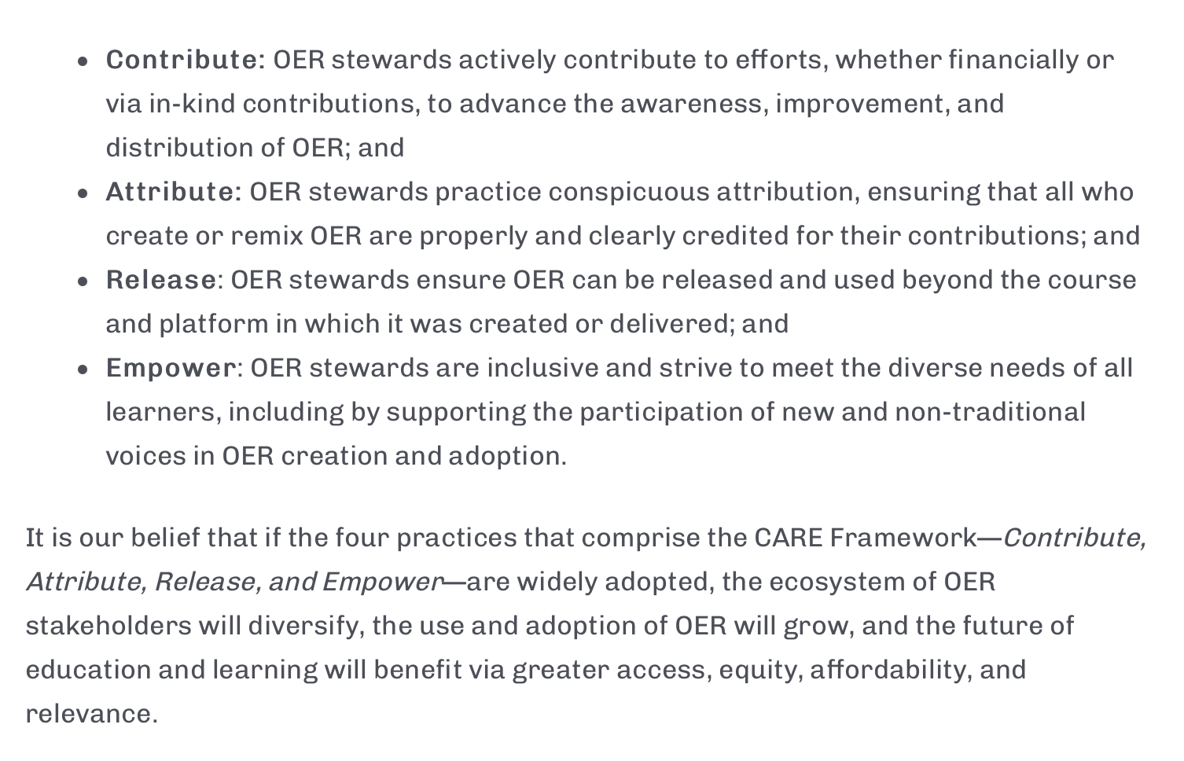

Slide 19
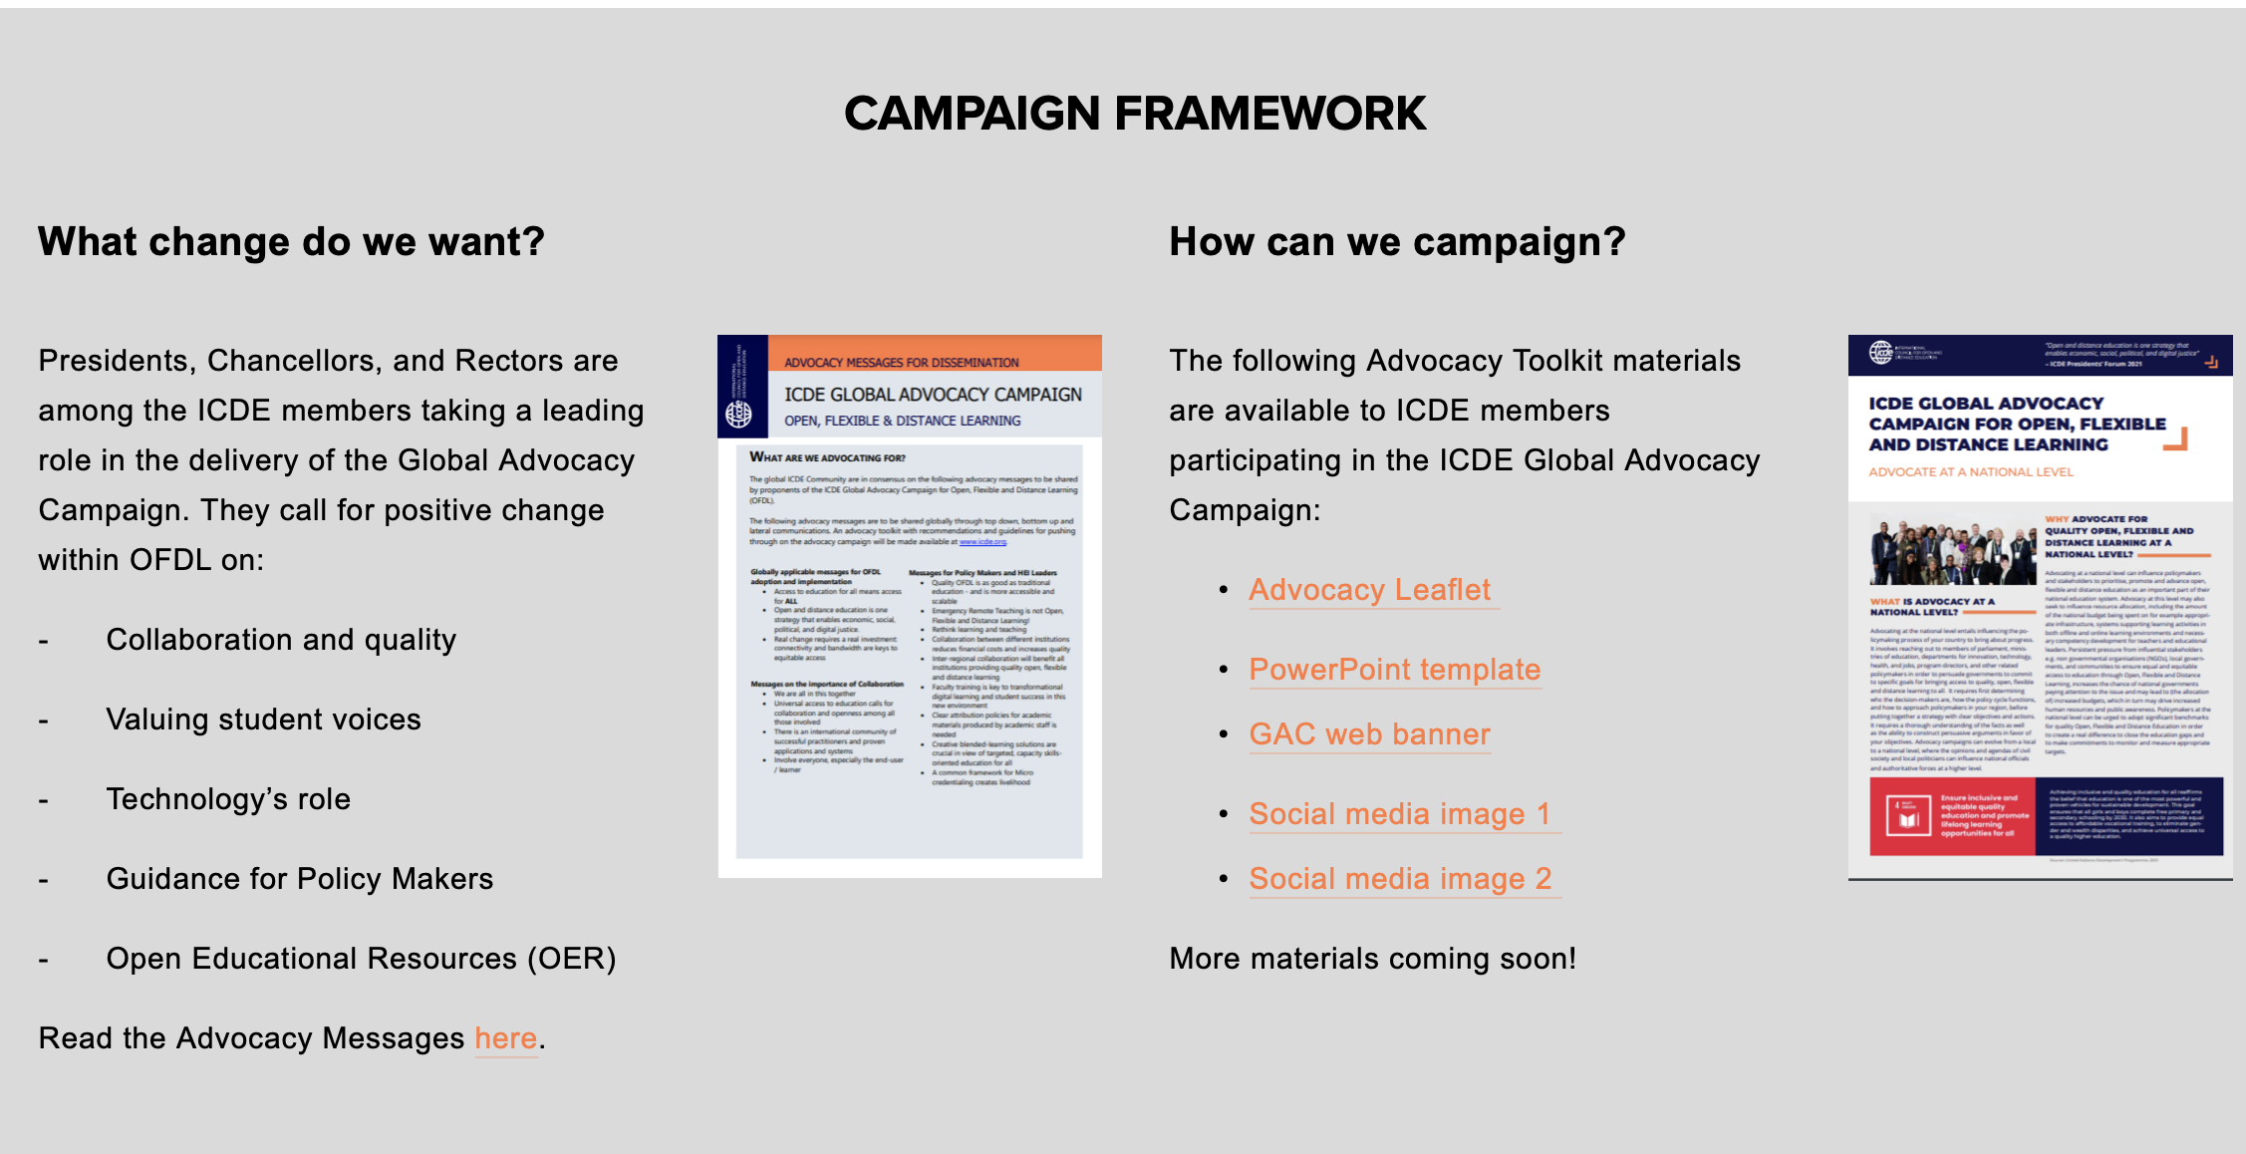
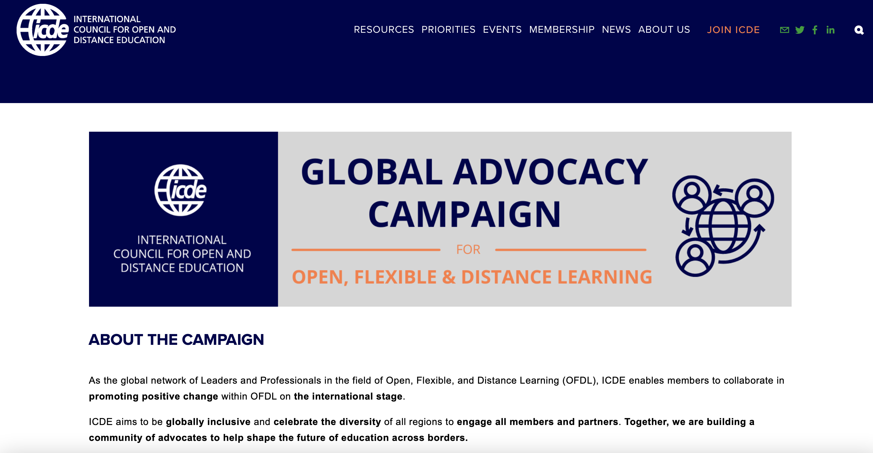

Slide 20
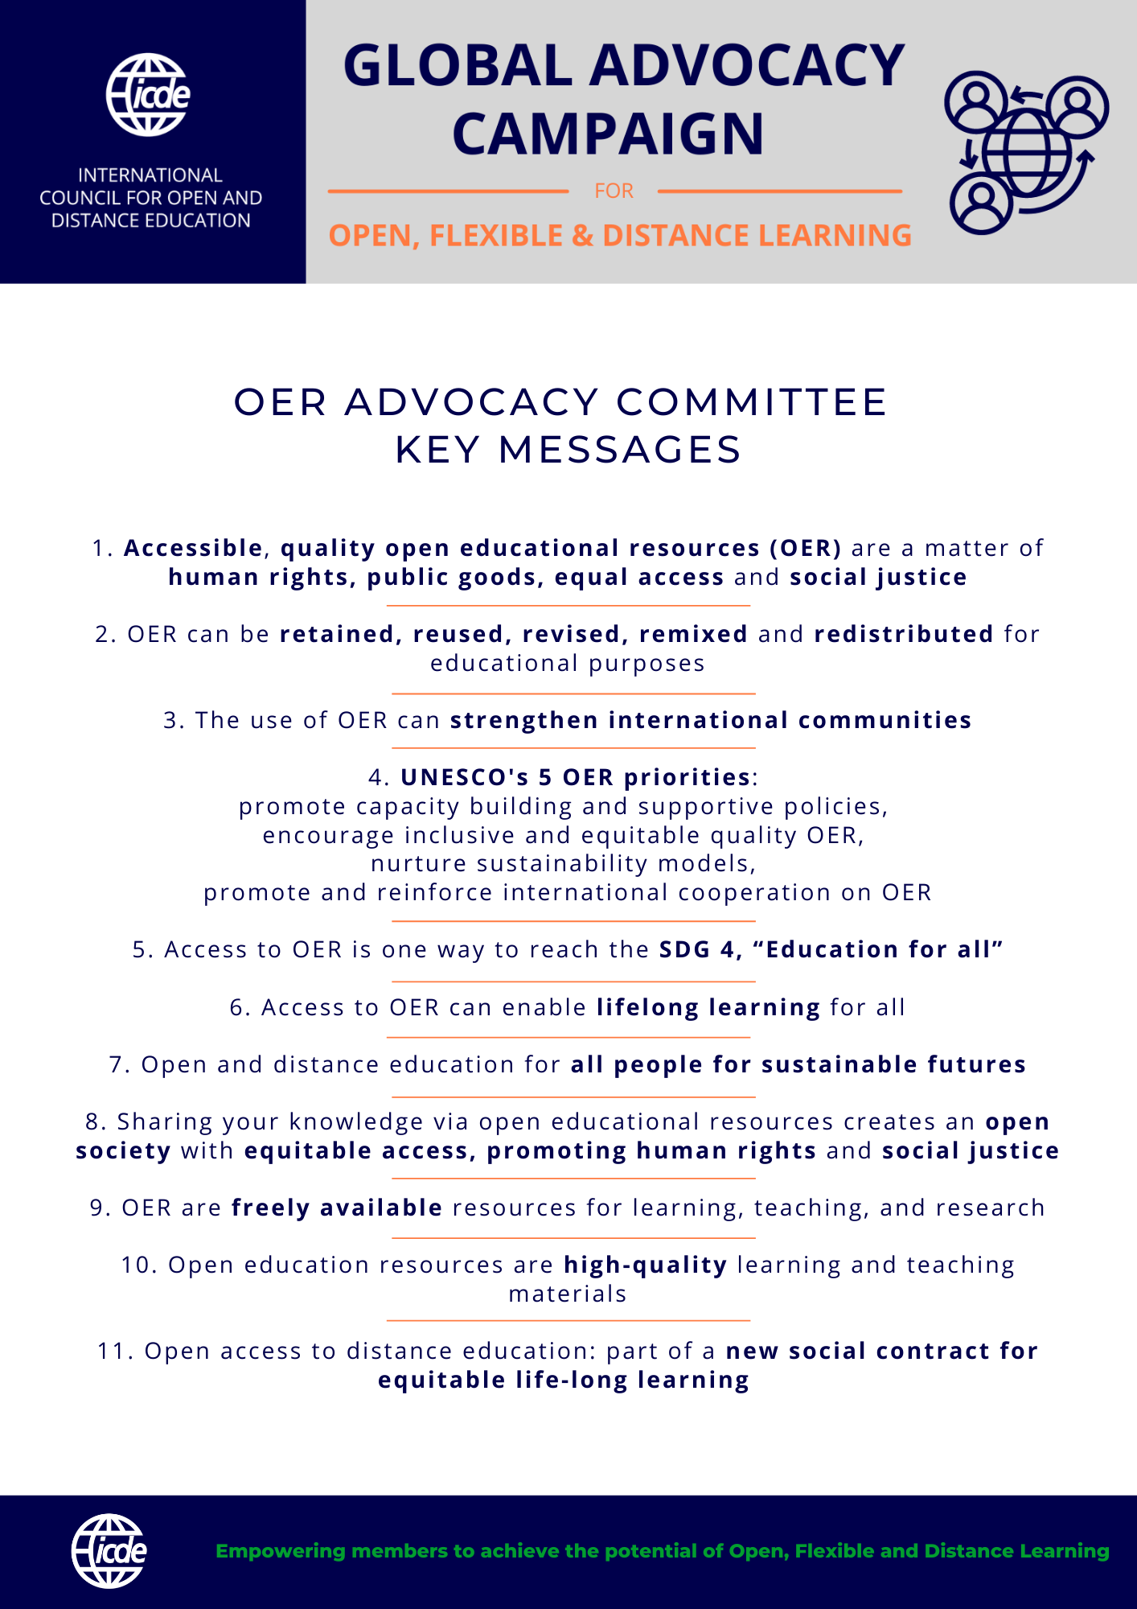

Slide 21
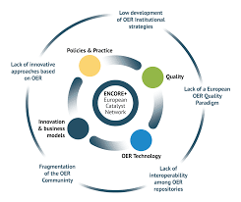
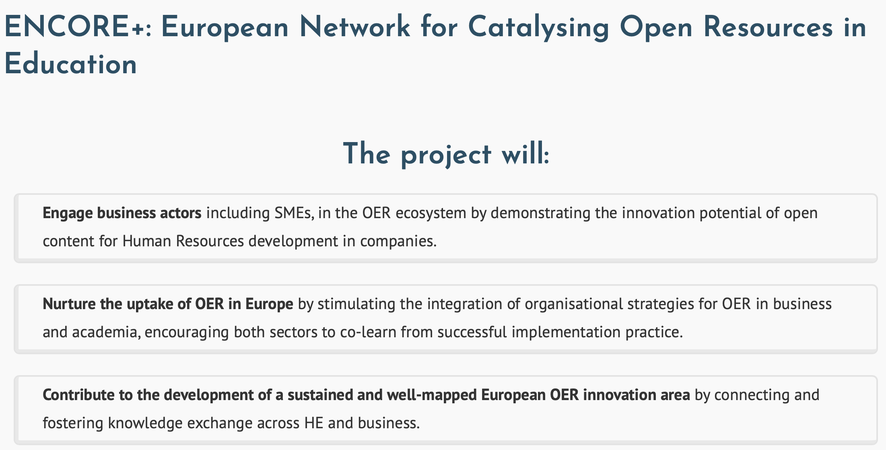
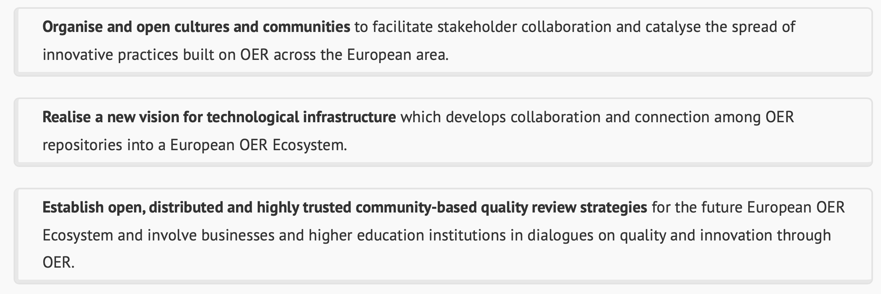

Slide 22
Öppet, flexibelt lärande och distansutbildning är en strategi som möjliggör ekonomisk, social, politisk och digital rättvisa för att möjliggöra personligt, kollaborativt livslångt lärande under hela livslängden som fokuserar på hälsa, välbefinnande, inkludering, jämlikhet och en smart framtid för individer och planeten .
Vägen framåt…

Slide 23
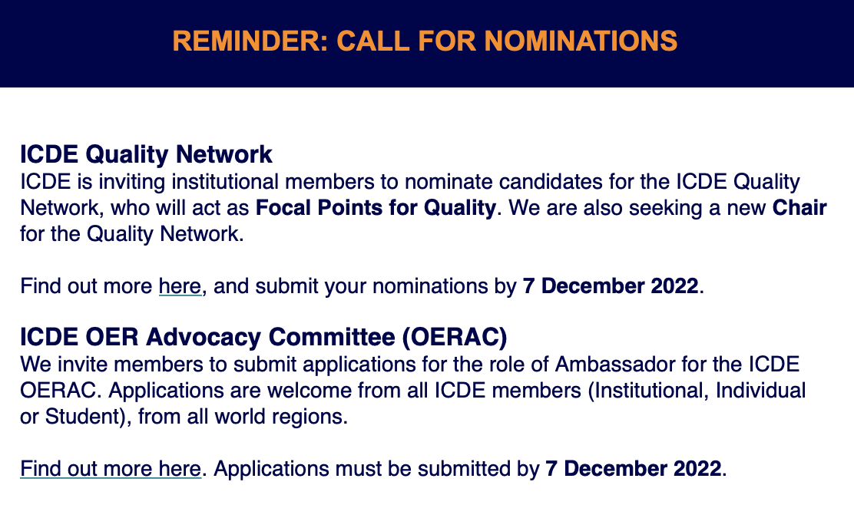

Slide 24

My Footprints
www.i4quality.se
Ebba.Ossiannilsson@gmail.com
info@i4quality.se
CARING IS SHARING, SHARING IS CARING
THANK YOU!

