Slide 1
ICDE
Global Advocacy Campaign

Slide 2
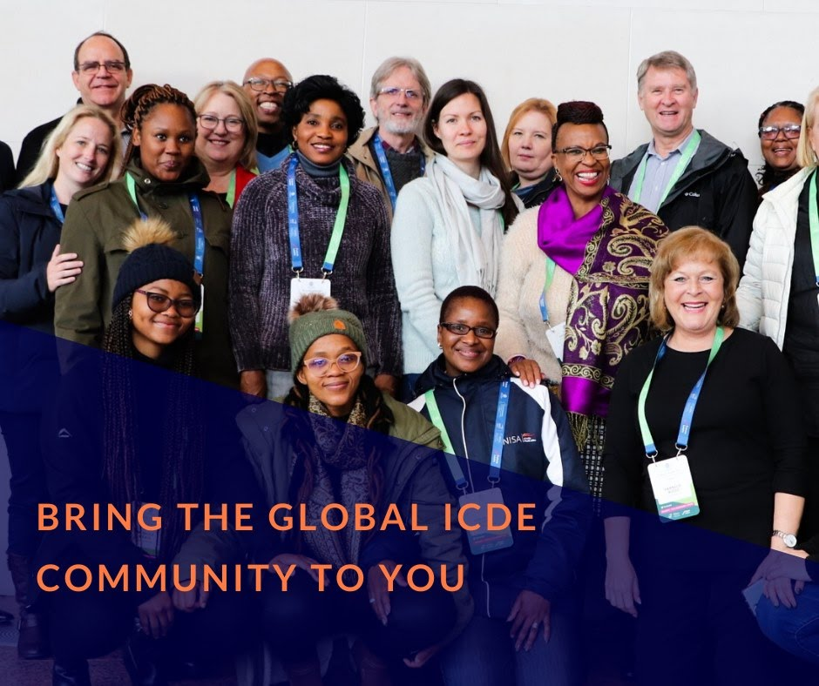
ICDE AT A GLANCE
OUR VISION
“To achieve the potential of Open, Flexible, and Distance Learning created through our members and learning communities.”
Space for graphics or images
OUR HISTORY
A global, not for profit NGO & membership association founded in 1938 in Canada
Hosted & part-funded by Norway since 1988
In formal consultative partnership with UNESCO
230+ members and partners

Slide 3
OUR GLOBAL OUTREACH
230+ members and partners
70 countries in all world regions
Impacting over 15 million students across all continents
Space for graphics or images

Slide 4
ICDE CORE STRATEGIC PRIORITIES (2021-2024)
Advocate globally for Open, Flexible and Distance Learning (OFDL) and enable regional and national influence through members and partners
Extend the global reach to underrepresented regions, new stakeholders and disadvantaged learner populations
Continuous work on the three prioritized areas:
Quality
OER
Innovation in education
Notes:
SO number 1 is: Advocate globally for Open, Flexible and Distance Learning (OFDL) and enable regional and national influence through members and partners. This strategic priority was made by the ICDE Board in the last part of 2020 – obviously related to the COVID-19 pandemic and the massive impact it had on the whole education system globally.
- Positive: many educators, teachers, faculty and students worldwide took a giant leap in developing OFDL provisions in a very short time. The only way education could continue was with online and distance education.
- Negative: the many examples of low quality ERT, due to unpreparedness, lack of competencies, necessary infrastructure, focus on student’s mental health and well-being, as well as high band-with costs and a difficult home situation for many learners.

Slide 5
ICDE MEMBERS LEADING THE WAY
Open and distance education is one strategy that enables economic, social, political, and digital justice
Notes:
Among ICDEs members we have many experienced providers of quality OFDL. They looked to ICDE, as the global membership association for OFDL, to advocate globally for what is quality education through various ways of online and distance provision, and what this in return requires of investment, support, infrastructure, regulations etc. in their local contexts. And not the least, it was important to ICDEs member to connect the global advocacy of OFDL to a greater societal value, linking open and distance education to the UN sustainable development agenda as a transformative power in itself.

Slide 6
GLOBAL ADVOCACY CAMPAIGN
icde.org/global-advocacy-campaign
Supporting local advocacy targeting regional challenges
Asia
Oceania
Latin America
Nordic
Utilising advocacy messages co-developed by ICDE members
Advocacy Toolkit with CC licensed materials translated to disseminate and adapt to local contexts
Step-by-step guidance on
stakeholder mapping and engagement
target audience
action framework
advocacy checklist
& specific topics
OER
Ethics - Globethics
Notes:
This is why we created the ICDE Global Advocacy Campaign. By empowering our members to act locally within a global advocacy framework, we aim to change the negative narrative of online and distance education fueled by the pandemic. We did this through a joint exercise where Presidents and Rectors of ICDE member universities collectively developed advocacy messages, and through them, showing relevance, urgency and proof of concept of what works, advocating for quality OFDL as a prerequisite for equitable and equal access to quality education and lifelong learning opportunities for all. (SDG4).
Explain about the task forces – regional and topical. Nordic Task Force led by SADE, thanks to Ebba and Ulf for their leadership in this. There is definitely a potential for closer collaboration between the Nordic actors and countries within our knowledge field. The OER specific task force is also led by Ebba Ossiannilsson, as she is the Chair for the ICDE OER Advocacy Committee, consisting of global ambassadors for Open Education from all world regions.
Together with our members Globethics, which is a global organization working for ethics in education, we will soon launch a topical advocacy campaign focusing on ethical aspects within OFDL.
Introduce the toolkit with message and step-by-step guide.

Slide 7
UTILISING GAC TOOLKIT
Available on the ICDE Global Advocacy Campaign webpage
Notes:
While the messages express what we want to change, the leaflet is a step-by-step guide on how to run a national campaign at a national level. As a part of the toolkit, we also provided templates for PP presentations and social media cards to disseminate specific messages.
While the task forces are run by ICDE members, all materials are freely available to anyone, as they are openly licenced materials – OER.

Slide 8
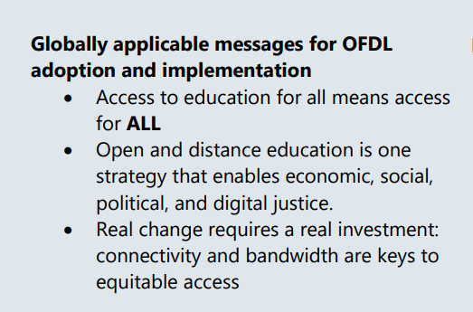
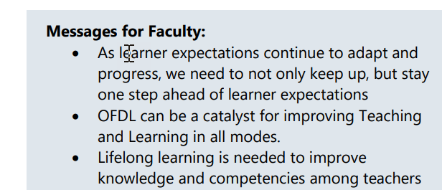
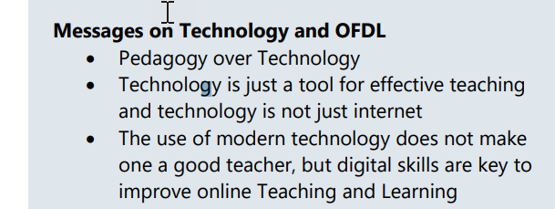
TARGETED MESSAGES
Who are you trying to reach? What do they care about?
Notes:
These are some of the examples of the messages that were developed by the ICDE Excecutive leaders. As you can see, they are targeted towards various types of audiences, trying to build on what is important to them.
The idea is that the local task forces can build on and extend these messages, so they become even more targeted for their purpose within their local contexts. For example, translation to a local language is core, as well as identification of the relevant stakeholders they would aim to target.

Slide 9
Notes:
This is an example created by the ICDE OER Advocacy Committee, who advocates for OER, Open access and Open Education. They developeed 11 new messages and translated the material into multiple languages.

Slide 10
JOIN THE GLOBAL ICDE COMMUNITY
Become a member
Subscribe to our newsletter
Follow us on Facebook, Linkedin and Twitter
Read our blog
Read our scientific Open Scholarly Journal Open Praxis

